Slide 1

Professional Advancement for FMs
Access the Value of IFMA
Notes:
IFMA helps facility managers advance personally and professionally through career development, learning, networking opportunities and leadership skills.

Slide 2
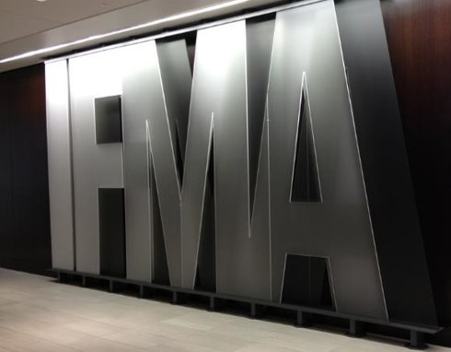
Who is IFMA?​
We are the most trusted and experienced facility management association​ in the world. We proudly serve more than 24,000 members in over 130 countries and are committed to advancing facility management worldwide​
Notes:
Founded in 1980, IFMA is the world's largest and most widely recognized association for facility management professionals, supporting more than 24,000 members in over 130 countries. We are a global association, committed to supporting FMs worldwide.

Slide 3

Vision
Lead the future of the built environment
to make the world a better place.
Mission
We advance our collective knowledge,
value and growth for Facility Management professionals
to perform at the highest level.
Notes:
Our programs were created to support our vision and our mission –
Our vision is to lead the future of the built environment to make the world a better place.
Our vision is to advance the collective knowledge, value and growth for facility management professionals to perform at the highest level.
We look forward to supporting the FM profession through the challenges of today and into the future.

Slide 4




Values That Drive Us
Global diversity, inclusion and social equality
Sustainability, resilience and responsible stewardship
Open, honest, transparent and interactive communications
Growth through innovation, leadership and sharing of knowledge
Notes:
As an association, we are deeply committed to helping our members thrive. These are the values of the association, staff and stakeholders, and guide us in everything we do.
We believe in Social Responsibility, the benefit of global diversity, inclusion and social equity.
We recognize Resilience and that sustainability, resilience and responsible stewardship of the environment is paramount.
We commit to Transparency, to open, honest, transparent and interactive communications.
We strive for Excellence and growth through innovation, leadership and sharing of knowledge.

Slide 5
Credentials and Training for the Career You Want
Notes:
IFMA is your resource for current training, networking and FM trends.
IFMA professional development fills your team’s knowledge gaps and equips them to excel; applying best practices and techniques of facility management gives your organization a competitive advantage in maintaining efficient and sustainable built environments while meeting the demands of the modern workforce.
IFMA professional development offerings are guided and produced by world-class experts and draw on our history as the industry leader in FM education. We offer the only industry credentials that are backed by the American National Standards Institute (ANSI), the foremost accrediting body in the U.S. ANSI provides an unbiased review of our credentialing programs that protects our integrity and bolsters international respect and confidence in our learning programs.

Slide 6




Skills You Need to Succeed
Essential FM Skills
Passion for
learning and industry trends
A solid foundation
in the fundamentals of FM
Determination to make an impact in your organization
Confidence
in your expertise
verified by credentials
Icons courtesy of the Noun Project
Notes:
The global demand for effective and efficient FMs is greater than ever. In the U.S. alone, the FM profession is outpacing the growth of other occupations by 3.5 percent on average.
What’s driving demand for highly trained and qualified FMs:
• Environmental impact awareness and regulation for businesses, as well growing global expectations for corporate social responsibility
• Developing technology increasing the efficiency of the built environment
• Emerging trend of digitalization, smart buildings, along with the increasing adoption of the Internet of Things (IoT) and cloud-based software
Facility managers will be needed to oversee these improvements in a wide range of areas, from heating and air-conditioning systems to roofing. In addition, facilities managers will be needed to plan for natural disasters, ensuring that any damage to a building will be minimal and that the organization can get back to work quickly.

Slide 7


Globally Recognized + ANSI-Accredited Credentials
Unbiased review of IFMA’s credentials
Protects integrity, value, and reputation
ANSI is North American arm of ISO
Notes:
Facility management is a vast, skillset-diverse profession that demands knowledge in multiple disciplines. No matter your learning goals, our professional development experts will help you curate the training your team needs for success.
IFMA training is tailored to your specific needs, it fills your unique knowledge gaps and sets you up for its greatest success.
Our FM training experts are ready to help you build your team’s best path to FM excellence via verified knowledge through credentials. You can also start with our career compass tool to find out what training is right for your career level.
We have the training and the credentials for every step in your career – from an introduction with the Essentials of Facility Management to the Certified Facility Manager for Experienced career professionals.

Slide 8

Notes:
Individual courses to help you meet your learning goals, no matter what they are. Whether you're looking to brush up on a particular subject or pick and choose topics that interest you most, IFMA's Online Training gives you the choice and flexibility to create a learning plan that works just for you.
Study what you want when you want. Start learning today with trusted content created by renowned facility management experts. Learn everything from budgeting to technology to maintenance. All at your own pace. The online catalog has self-paced courses designed for you to learn what you need, when you need it, and covers all 11 FM core competencies.
In addition, we have a career compass that will help FMs find the right training for their career level.

Slide 9

Group Training
Performance with IFMA credential increases an average of 40%
On average, IFMA credentials lead to a $6,000 salary increase within the first year
Notes:
IFMA also offers opportunities tailored to your company’s needs. Our goal is to advance the profession by offering best-in-class education. IFMa clients with multiple training participants enjoy discounts, and all group training clients receive concierge style service. We can assist you with enrollment and rollout, course kick-off, detailed progress reports and completion forecasts.
Special pricing applies for groups of 2 or more individuals. Contact us at corporateconnections@ifma.org to learn more.

Slide 10
Networking for Advancement
Notes:
IFMA networking opportunities connect facility professionals –online and in person. With your IFMA membership, you will make the connections and build the relationships needed for a successful career in facility management. With IFMA, FMs can build the relationships needed for a successful career.
FMs can access resources to grow their careers on JOBnet, including career coaching and planning. JOBnet also includes resume tips, interview prep and the most active FM job board on the web.
FM students can apply for Academic Scholarships awarded by the IFMA Foundation.
Members have access to the IFMA Member Directory – to build and grow their networks.
Connect with the IFMA Community on social media – on LinkedIn, Instagram, Youtube, Facebook and Twitter.
Events are always a way to connect with others in the profession.

Slide 11
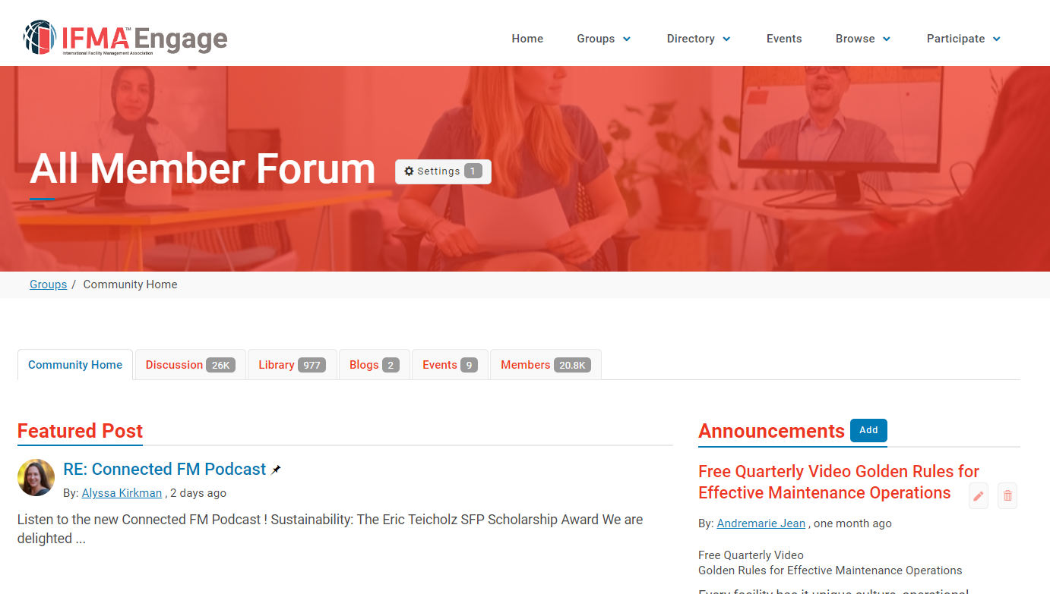
Notes:
The Engage Forum is the easiest way to connect with FM colleagues from around the world. IFMA Members can join the conversation to learn from the discussions – or post a question. Discussions cover the wide range of FM topics – everything from trash can placement to technology solutions to personnel best practices – members can learn from each other with the click of a button.

Slide 12

Local Networking with Chapters
Notes:
With more than 24,000 IFMA members around the globe, finding the right connections might seem daunting. That’s why IFMA has focused groups ​that help members network based on what matters to them. These groups, collectively called components, make it easier for you to connect with fellow members with whom you share common ground ― whether ​it’s by location, the industry or building type in which you practice, or a specific FM topic of interest.
Chapters are the best way to connect with other FMs based on location. Members can add a chapter to their membership at any time.

Slide 13
Industry Networking with Councils
Legal Industry
Manufacturing
Museum/Cultural Institutions
Nonprofit Facilities
Public Sector
Research & Development
Retail Facilities
Utilities
Academic Facilities
Airport Facilities
Banking Institutions & Credit Unions
City & Country Clubs
Corporate Facilities
FM Consultants
Health Care
Hospitality
Notes:
IFMA Councils help connect members who practice FM in similar industry sectors or facility types. IFMA formed councils to meet the industry-specific networking and information needs of its members. Truly global in nature, councils are not limited by geographic boundaries. You can communicate with colleagues worldwide about issues, concerns and best practices specific to your area of facility management. Members are welcome to join a community at any time by adding it to their membership.

Slide 14







Topical Networking with Communities
Notes:
IFMA Communities of Practice help connect members who share an interest in a particular FM topic, regardless of location or industry. IFMA formed communities to meet Core Competency specific networking and information needs of members. Truly global in nature, communities are not limited by geographic boundaries. You are able to communicate with colleagues worldwide about issues, concerns and best practices specific to your ​interests. Members can add a council to their membership. Members are required to join a chapter, council or community their first year, and they can join as many as they choose.

Slide 15

Leadership Opportunities
Volunteer as a content expert
Submit an article
Submit a presentation
Become involved on a local level
Notes:
FMs can make a lasting contribution on IFMA and the profession by taking advantage of IFMA leadership opportunities. Transform your research, best practices and lessons learned into an article, white paper or presentation. This is your opportunity to join other trailblazers, trendsetters and topic authorities in sharing your thought-leading content with a global audience of FM professionals. You can lead by:
Volunteering as a content expert in IFMA’s member-only Knowledge Library and playing a key role in shaping the knowledge landscape.
Submitting an article to FMJ, IFMA's official magazine.
View Open Calls for presentations on the IFMA website and submit to an IFMA event.
Becoming involved in local chapters and communities and advancing to leadership positions – and finding out what events you can attend and provide content for.

Slide 16

Advocacy
Providing reliable on issues affecting the built environment
Creating common​-sense solutions for energy-efficient building initiatives
Highlighting the importance
of education and training
Notes:
IFMA is committed to working with public and private sector partners to magnify the facility management profession by providing reliable information to government leaders around the world on issues affecting the built environment. IFMA monitors issues and maintains advocacy efforts in the U.S. (at both the state and federal levels) and EU.
Every September, IFMA holds an Advocacy Day and Public Policy Forum in Washington, D.C., USA. This free event allows IFMA members and chapter leaders in the U.S. to utilize their experience and expertise in FM to help inform the public policy process.

Slide 17
Events to Grow Your Career
Notes:
Make connections and grow your professional network at some of the most exciting facility management events in the world.
Our events are designed for facility management professionals of every career level and help you connect with other professionals. Gain insights and knowledge from world-renowned speakers and thought leaders and develop personal and professional skills. See the latest FM tools and solutions through product demonstrations and one-on-one discussions with the leading names in FM in the exhibit and educational arenas. Receive top-notch education and learn the latest FM trends, innovations and best practices used in the industry.

Slide 18


IFMA Events
Notes:
IFMA’s World Workplace® is the original educational and networking event for facility management. World Workplace is the gold standard in facility management education, knowledge exchange, career development and professional network building.
Facility Fusion is the FM leadership event of the year - an opportunity for facility professionals at every career level to focus on personal leadership skills and career development.
Events are also held in Europe, Asia, Latin America and India.

Slide 19
Resources for Success
Notes:
Imagine the information and resources that IFMA’s community of 22,000+ people provide. IFMA has the opportunities for you to grow in your career.

Slide 20

Industry Information
The Wire
The Insider
IFMA’s FMJ
FM Buyer’s Guide
Notes:
As a member, you will receive up-to-date information and have access to member-only content including:
E-newsletters that provide current information on IFMA and the industry - The Wire for IFMA news, training and resources and The Insider for industry news and business trends from around the world.
FMJ offers practical takeaways and global best practices. IFMA’s official magazine is written by FM professionals, for FM professionals. Members pay just $48 for a print subscription – a $36 savings - and can access the online version at any time.
The online FM Buyer’s Guide assists members with making purchasing decisions.

Slide 21
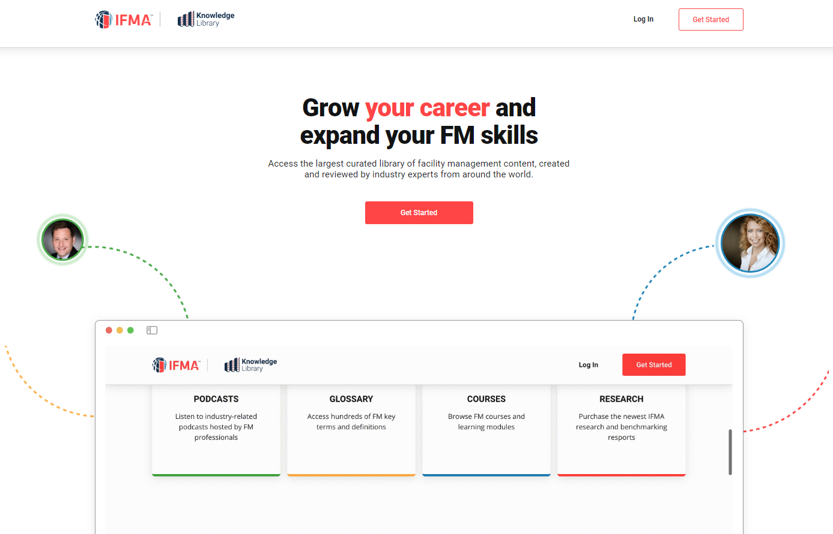
Notes:
The IFMA Knowledge Library includes hundreds of valuable articles, benchmarking reports, case studies and research. Members get free access to the entire library. The Knowledge Library is your gateway to hundreds of valuable articles, benchmarking, case studies, research and more all conveniently located in a single location. And, much of the access to the library is 100% free to you, just for being a member of IFMA!
Expect to grow your facility management knowledge and career faster than ever before.
If you want to unlock even more content, and get access to templates, videos and other premium, original content exclusives, upgrade your access with a Knowledge Pass subscription.

Slide 22
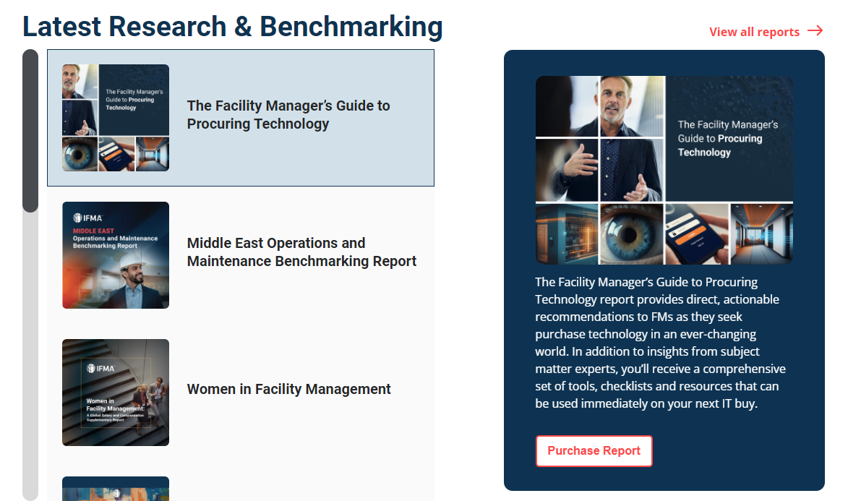
Notes:
IFMA delivers high-impact research and invaluable benchmarking data members can use to forge their careers. Whether the focus is on industry averages, benchmarking statistics or the latest workplace trends, IFMA is an information leader for the FM profession.
From industry surveys to forecasting to benchmarking reports, IFMA's research draws on the practices and opinions of FM professionals and educators, covering topics vital to the day-to-day operations of facility professionals and the built environment in general.

Slide 23


Additional Resources
Notes:
IFMA’s Awards of Excellence recognize the outstanding achievements of individual members, chapters, councils, communities and partners. Each year, awards are presented at World Workplace, honoring those who have made exceptional contributions to the advancement of the FM profession and the association.
The IFMA Foundation is dedicated to the mission of promoting education for the facility management profession around the world and making FM a Career of Choice. here is what the IFMA Foundation does:
Accredits and recognizes Facility Management (FM) higher education degrees and fosters the development of new programs in schools and universities. Accredited degrees meet the FM Accreditation Commission’s (FMAC) highest standard, ensuring students have appropriate understandings in all 11 FM core competencies. Recognized programs are high quality degrees and certificates that meet the majority of the accreditation standards.
Introduces FM as a career of choice early in a student’s educational journey at high schools, community or two-year colleges, and universities. This early education increases the talent pool for FM internships, scholarships, and eventual employment.
Promotes FM workforce growth by facilitating regional coalitions **of** that result in nearby FM training and educational offerings, school and job placement programs that support the profession locally.
Creates innovative and educational multimedia, publications and events which focus on advancement and awareness of the profession.

Slide 24
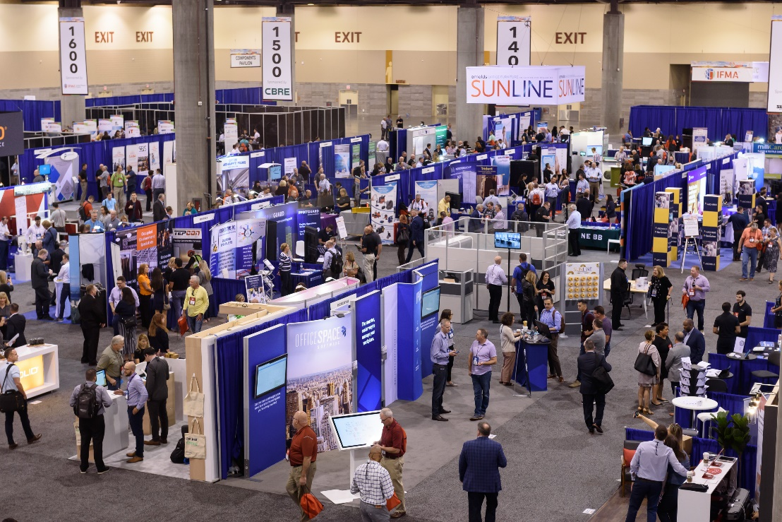
Promotional Opportunities
Exhibits
Sponsorship
Corporate Partnership
Advertisements
Notes:
IFMA events provide promotional opportunities for all FM related businesses. IFMA serves as the ultimate resource for facility management professionals who are looking for the best products and services for their buildings. Through IFMA, you can connect directly to the largest community of FMs in the world.
IFMA’s Corporate Sustaining Partner (CSP) makes a strong commitment to the association and the profession. In return, IFMA commits to providing access to its various channels to better our partner’s position as an industry thought leader, strong advocate for the advancement of facility management and active professional partner in shaping the future of FM.
In print, on the Web, via email and in person — so many ways to reach the leading decision makers in FM! Advertise in FMJ, on the website , in theFM Buyer’s Guide or an e-newsletter.
IFMA hosts several major educational and networking events each year. Facility management professionals attend these events to acquire the most relevant and reliable information concerning global workplace issues and solutions. Exhibitors can introduce solutions to FMs, establish company and brand as a leader, and much more.
Underline your direct contribution to the quality of IFMA resources and events as a sponsor. Through the generous support of our sponsors, IFMA has the ability to deliver high-quality experiences and cutting-edge information to the facility management community.

Slide 25
IFMA Membership
Notes:
Achieve your goals faster with an IFMA Membership.
IFMA’s 40+ years of knowledge and expertise enables, empowers and equips FMs to solve challenges today and in the future. Join today to propel your career forward, keep pace with a changing industry and bring added value to your organization. We hope you will become part of a network of facility management professionals whose expertise and insights will help bolster your career while benefiting the wider built environment.

Slide 26
IFMA Member Benefits
Career
Credentials
eNewsletters
IFMA’s FMJ
Buyer’s Guide
Benefit of the Month
JOBnet
Training
fm.training
Free Intro to FM module
Free Quarterly Video
Webinars
Benchmarking
Knowledge Library
Events
World Workplace
Facility Fusion
Global Events
Local Events
Networking
Leadership
Engage Forum
Chapters
Councils
Communities
Member Directory
Fellow Directory
Advocacy
Awards of Excellence
Local Groups
Content Creation
Notes:
IFMA membership has the power to accelerate your career. Full Members receive discounts and access to member only opportunities. Discovery members receive limited access to benefits.
THE CAREER RESOURCES YOU NEED TO SUCCEED
Propel your career forward, find better solutions faster, keep pace with the changing industry and bring additional value to your organization with IFMA's programs and services.
THE TRAINING YOU NEED FOR THE CAREER YOU WANT
IFMA's educational offerings help facility professionals from all backgrounds and experience levels develop the skills they need for career advancement.
THE NETWORKING YOU NEED TO ADVANCE
With your IFMA membership, you will make the connections and build the relationships needed for a successful career in facility management.
THE LEADERSHIP OPPORTUNITIES YOU NEED TO MAKE AN IMPACT
Make a lasting contribution on IFMA and the facilities management profession by taking advantage of an IFMA leadership opportunity.
THE EVENTS YOU NEED TO GROW YOUR CAREER
IFMA Events are designed for FM professionals of every career level and will help you develop personal and professional skills.

Slide 27
Find Your IFMA Membership
Full Membership
Limited Membership
STARTS AT*
$239/yr
For facility practitioners and educators who work in, oversee or teach in the field of FM.
Industry-leading training
Discount pricing
Career advancement
Local networking
FM Professional
STARTS AT*
$239/yr
For business development, sales, marketing and FM consultant professionals.
Access to decision makers
Discount pricing
Grow your credibility
Connect with FMs and leaders
Associate
STARTS AT*
$149/yr
For facility management professionals age 35 and under.
Great job opportunities
Discount pricing
Professional network growth
Gain confidence as a FM
Young Professional
Discovery
$49/yr
Limited membership for those interested in facility management or who work in other professions.
Intro to the FM industry
Latest news and info
Limited member benefits^
Available to new members only
* Full first-time members must join a chapter, council or community for their first year of membership
^ Discovery members have access to limited membership benefits.
Notes:
In order for you to get the most in your first-year with IFMA, new full members are required to join a chapter, council or community. After the first year of membership, local chapter, council or community membership is optional.
Discovery members have access to limited membership benefits- the list is available on the website.
If your company/organization has 10 or more employees who support your workplace, consider the benefits of a group membership plan. Ensure that your team has access to informative, skill-building resources essential to maintaining sustainable, productive, safe and successful facilities. In addition to a discounted rate for base membership, IFMA’s group membership plan offers the convenience of a single annual billing statement. “​Group” is defined as 10 or more employees from the same company.
Corporate Sustaining Partners also qualify for special membership pricing.

Slide 28

Questions?
Call or visit ifma.org for more details.
Notes:
I encourage you to engage and use IFMA to propel your career forward, keep pace with a changing industry and bring added value to your organization. I hope you start engaging in the IFMA community today.
If you have any questions, the website is a great resource. You can also reach out directly to the team.

